Slide 1
Pelton Turbine

Slide 2
HYDRAULIC TURBINES
Introduction:
The device which converts hydraulic energy into mechanical energy or
vice versa is known as Hydraulic Machines. The hydraulic machines
which convert hydraulic energy into mechanical energy are known as
Turbines and that convert mechanical energy into hydraulic energy is
known as Pumps.
Fig. shows a general layout of a hydroelectric plant.

Slide 3
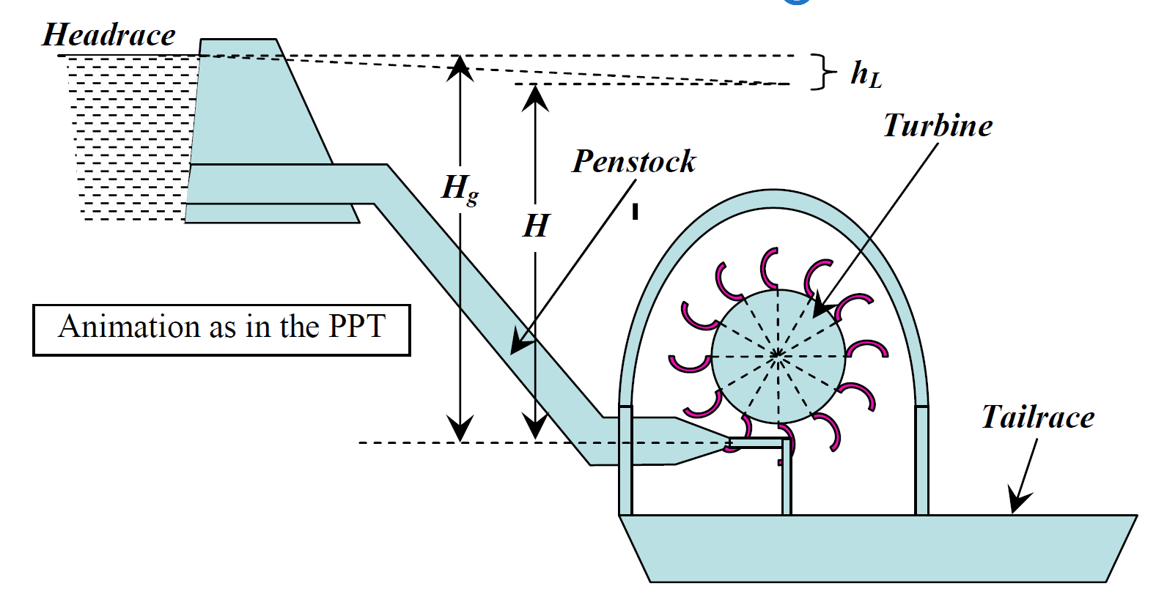
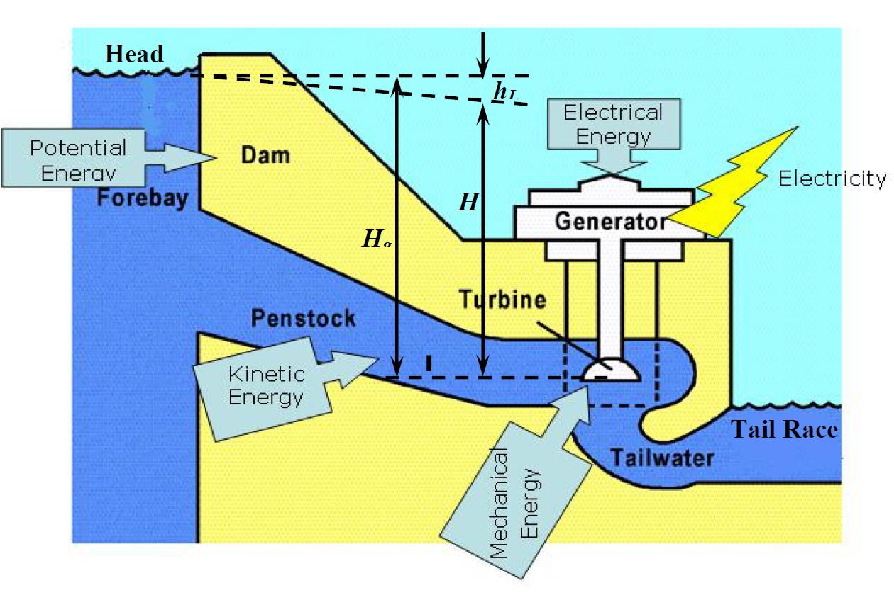

Slide 4
Turbines:
Impulse
Pelton wheel
Turgo
Crossflow
Reaction
Radial (e.g. Francis)
Axial (e.g. propeller, bulb, Kaplan)

Slide 5
layout of a hydroelectric plant
1. A Dam constructed across a river or a channel to store water. The reservoir is also known as Headrace.
2. Pipes of large diameter called Penstocks which carry water under pressure from storage reservoir to the turbines. These pipes are usually made of steel or reinforced concrete.
3. Turbines having different types of vanes or buckets or blades mounted on a wheel called runner.
4. Tailrace which is a channel carrying water away from the turbine after the water has worked on the turbines. The water surface in the tailrace is also referred to as tailrace.

Slide 6
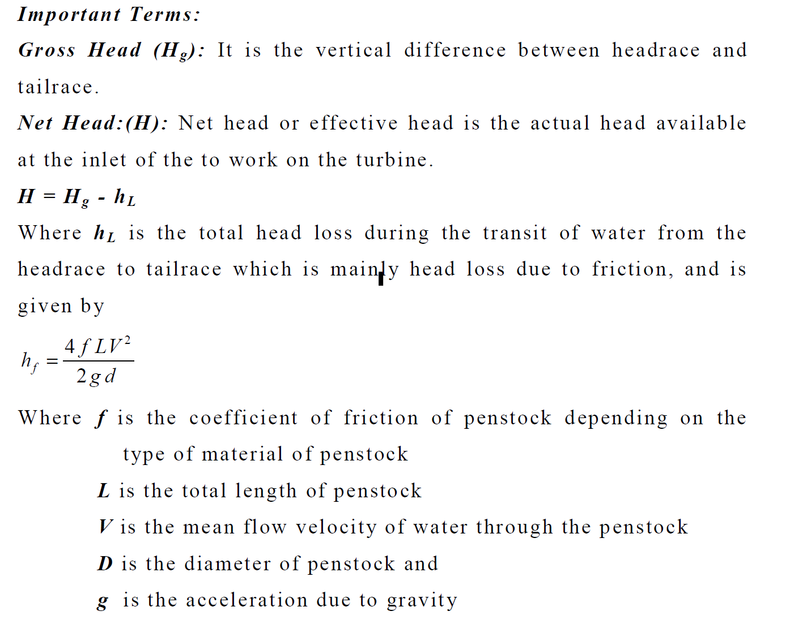

Slide 7
Contains:
Introduction
construction
Working
Calculation ( v Δ)
Design aspects
η
Pelton turbine in Nepal
Problems

Slide 8
1.Introduction :
It is impulse turbine.
Pressure energy is converted into KE when passed through nozzle.
Free high velocity water jet impinge on the bucket mounted on the periphery of the runner.
Impulse force on the bucket rotates the runner.

Slide 9
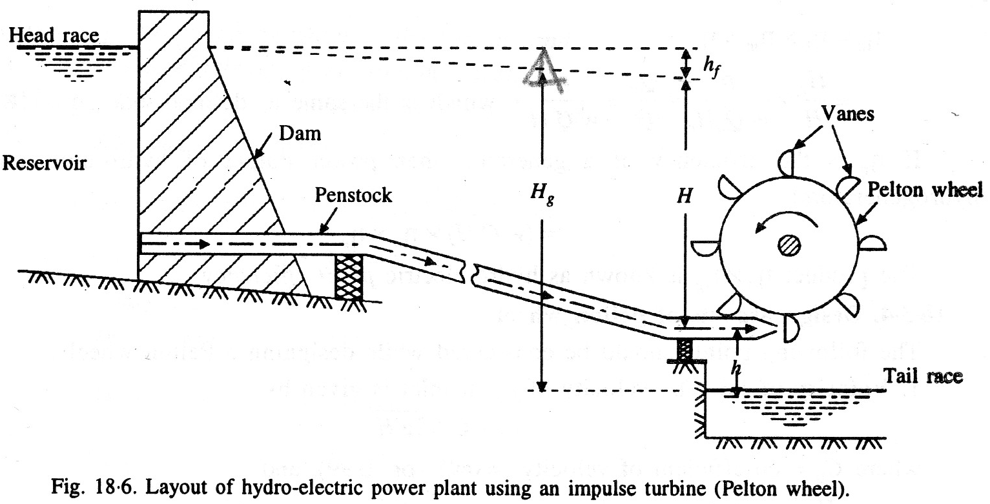

Slide 10
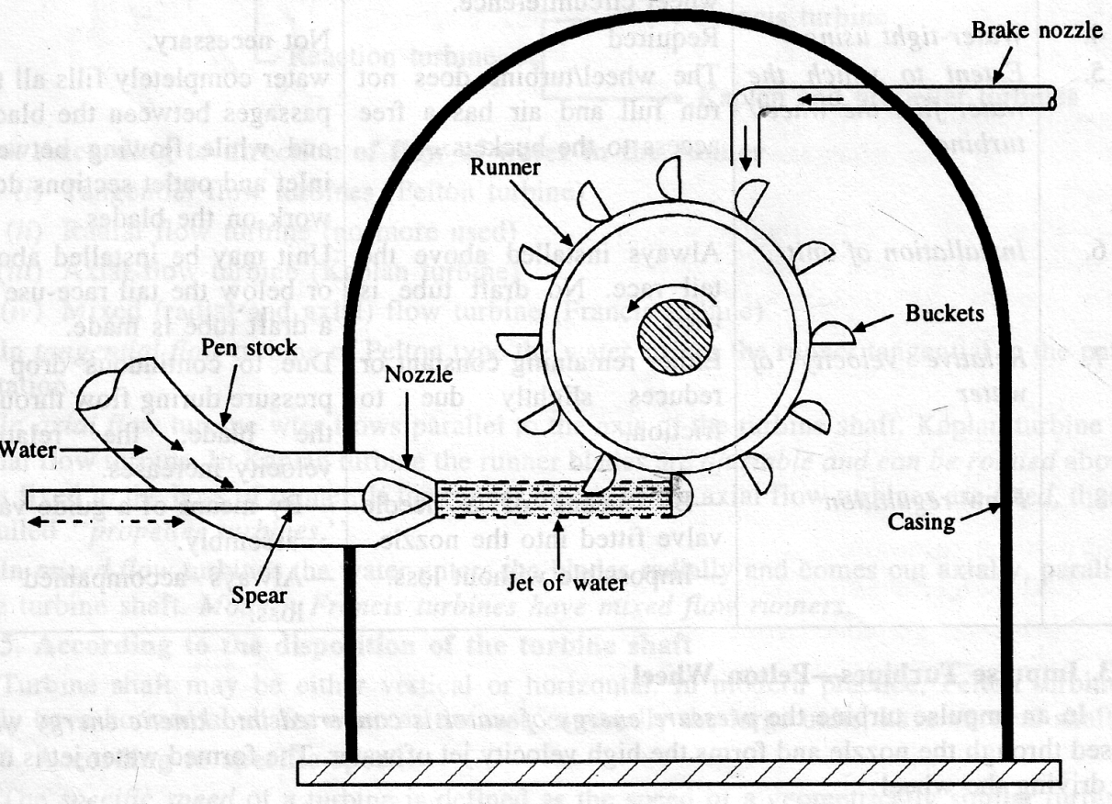
Construction (different Parts):
Max. 6 nozzles

Slide 11
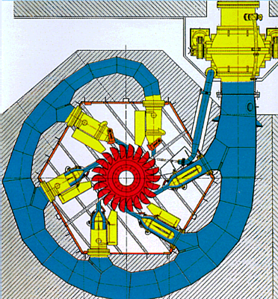

Slide 12
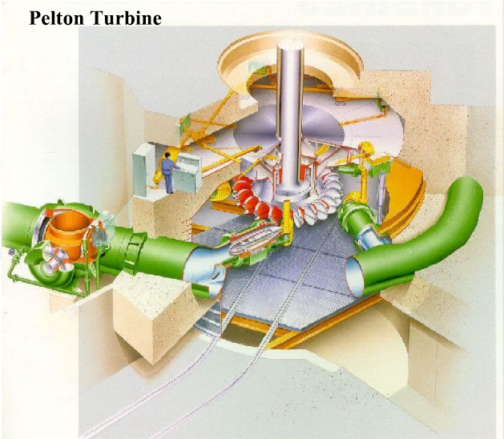
Pelton Turbine

Slide 13
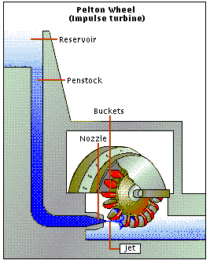

Slide 14
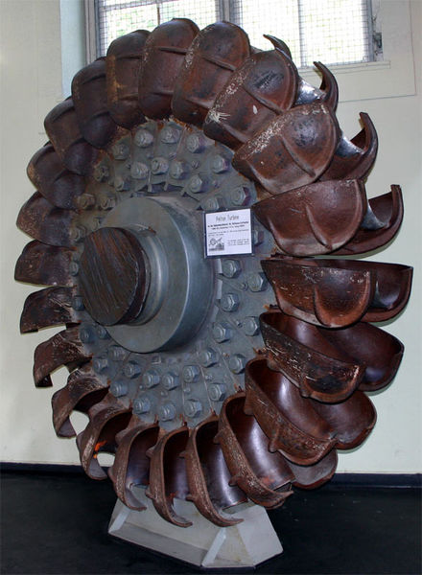

Slide 15
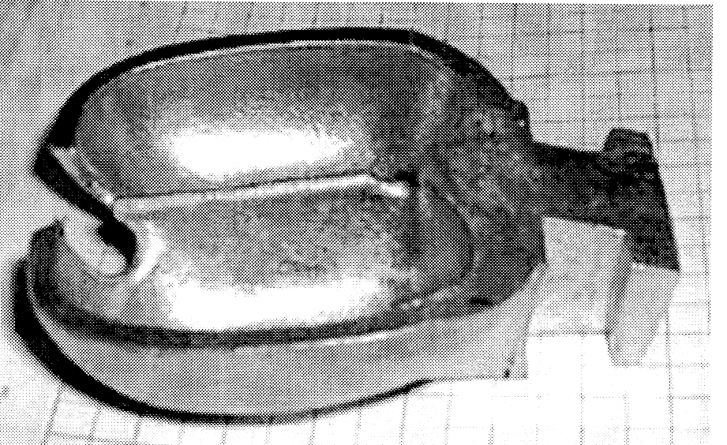
Bucket:

Slide 16
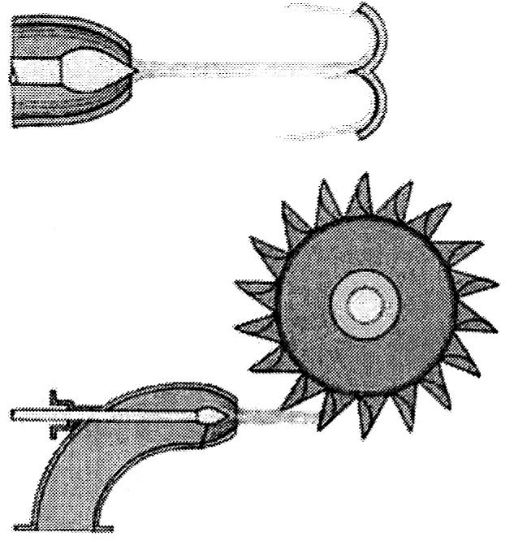
Nozzle striking the bucket:

Slide 17
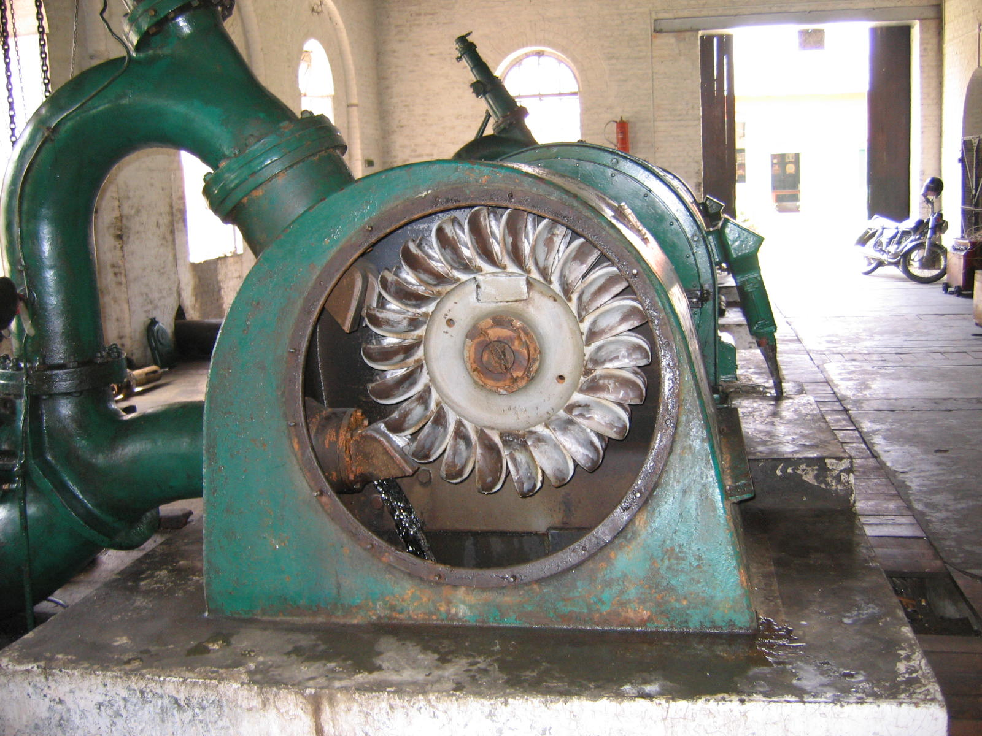

Slide 18
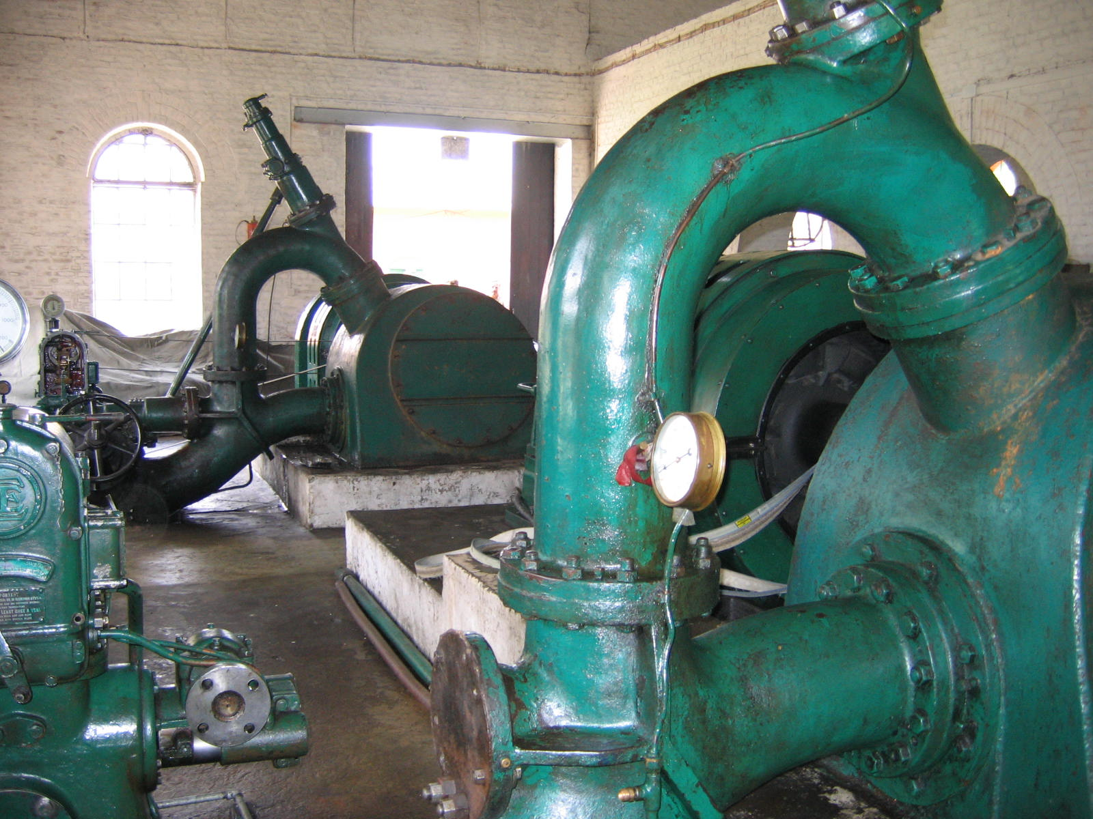

Slide 19
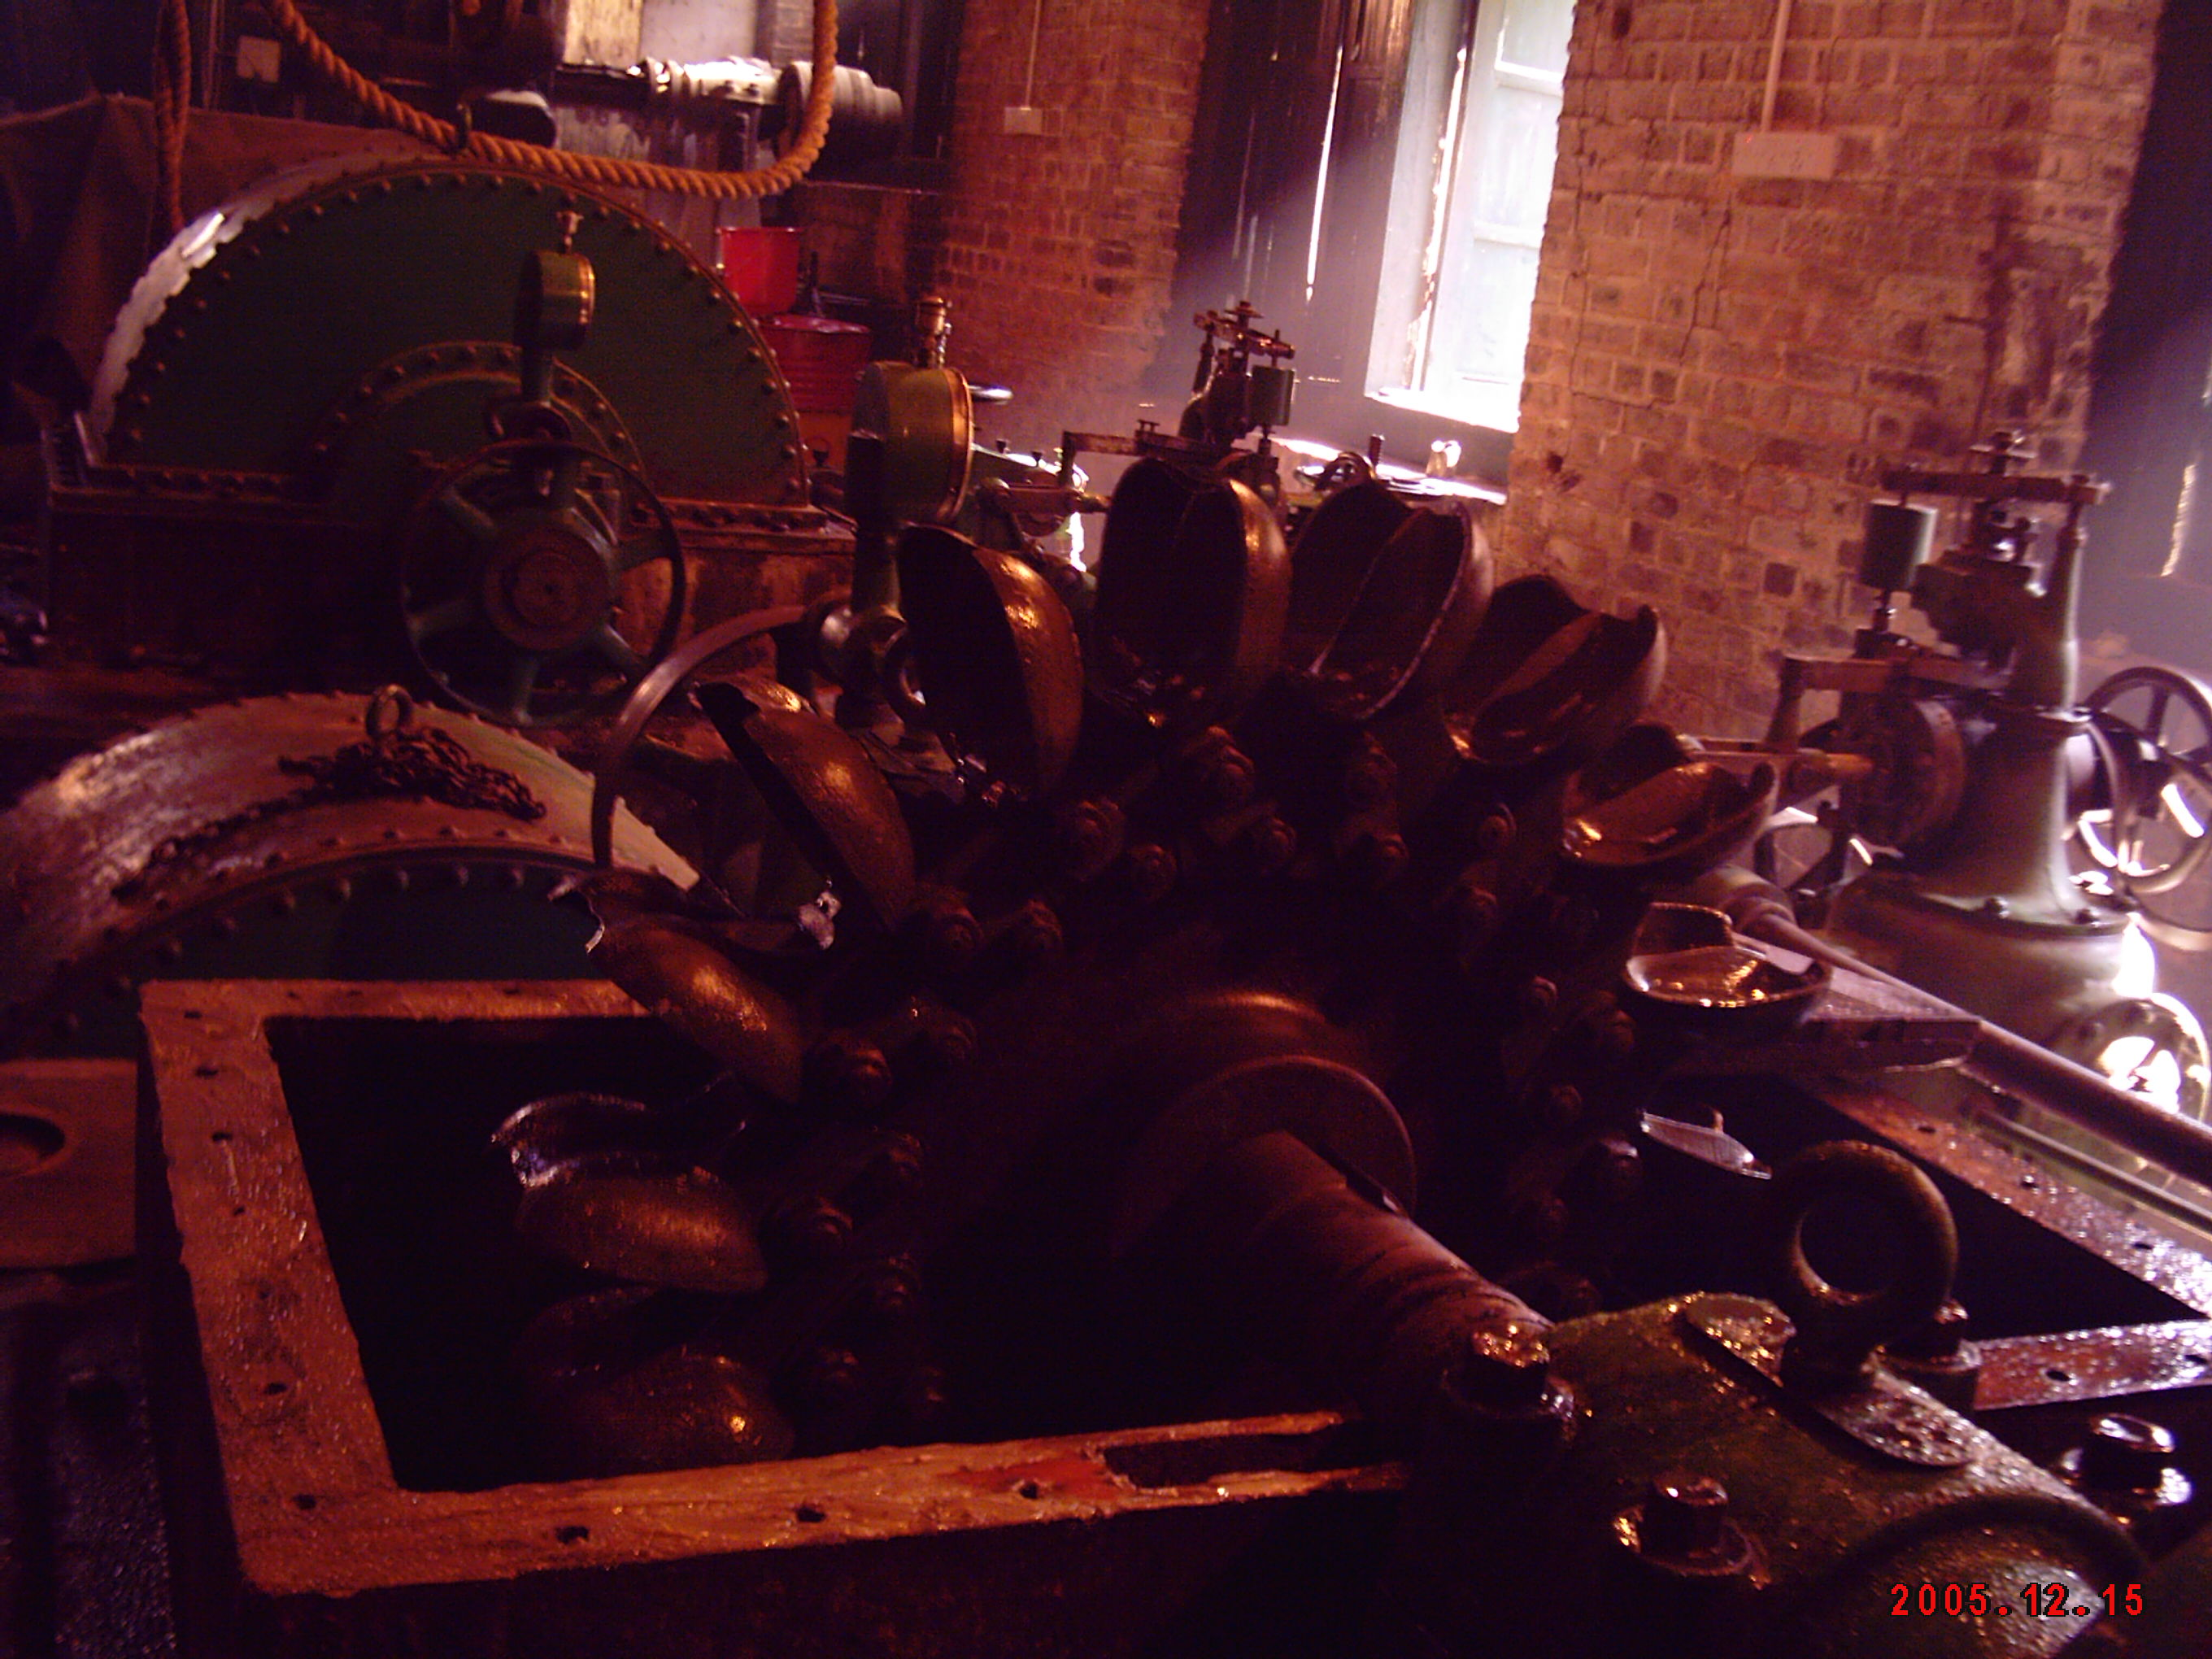

Slide 20
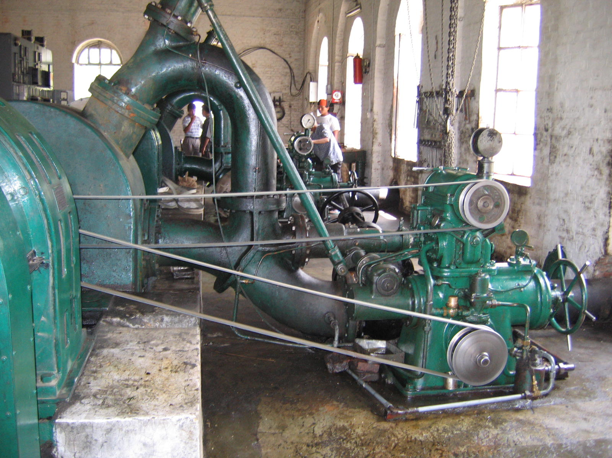

Slide 21
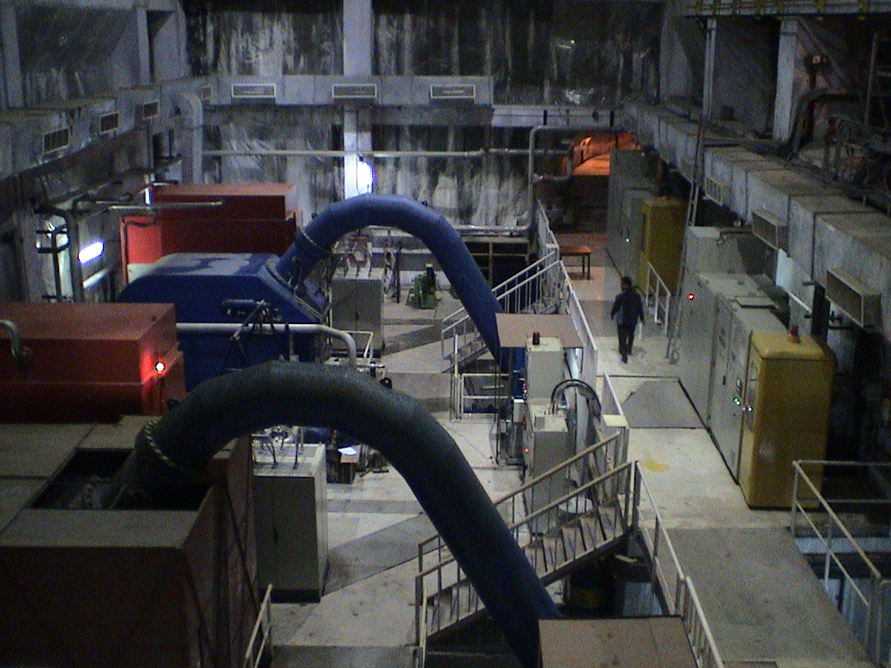

Slide 22
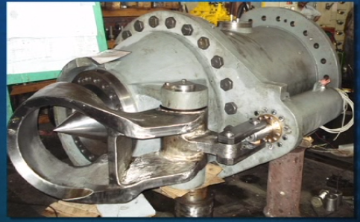
Spear valve and jet deflector

Slide 23
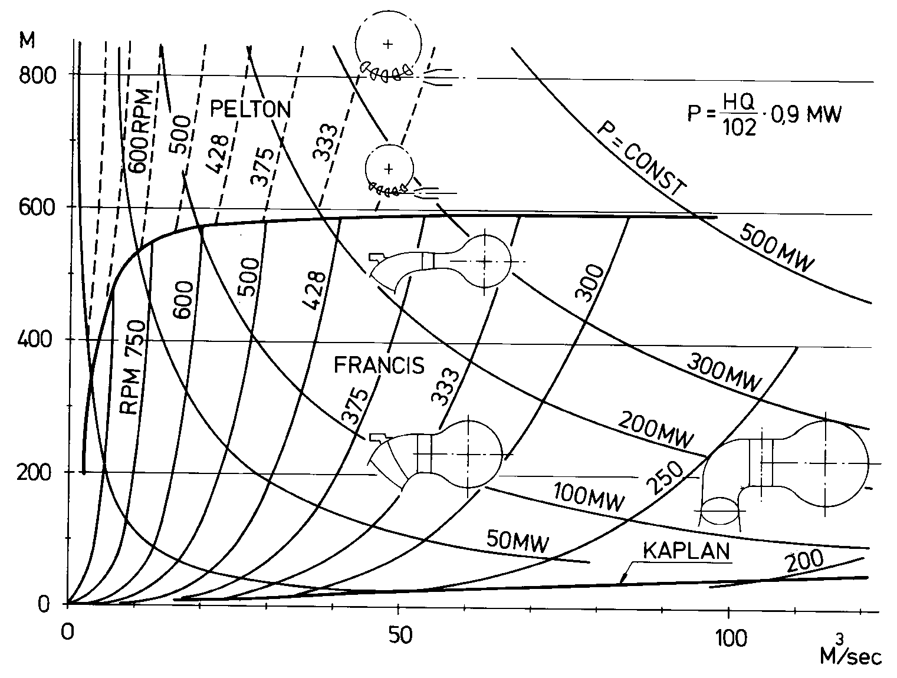
When to use a Pelton turbine

Slide 24
3.Working-1:
All the PE is converted into KE at nozzle.
Pressure all over the wheel is P_{atm}.
Energy transfer is purely impulse action.

Slide 25
3.Working-2:
Governing mechanism: To keep runner speed constant by varying flow rate when load fluctuate.
Inlet angle at the jet is 1~3° due manufacture difficulty.
Deflection angle is 165~170 ° not to disturb incoming jet.

Slide 26
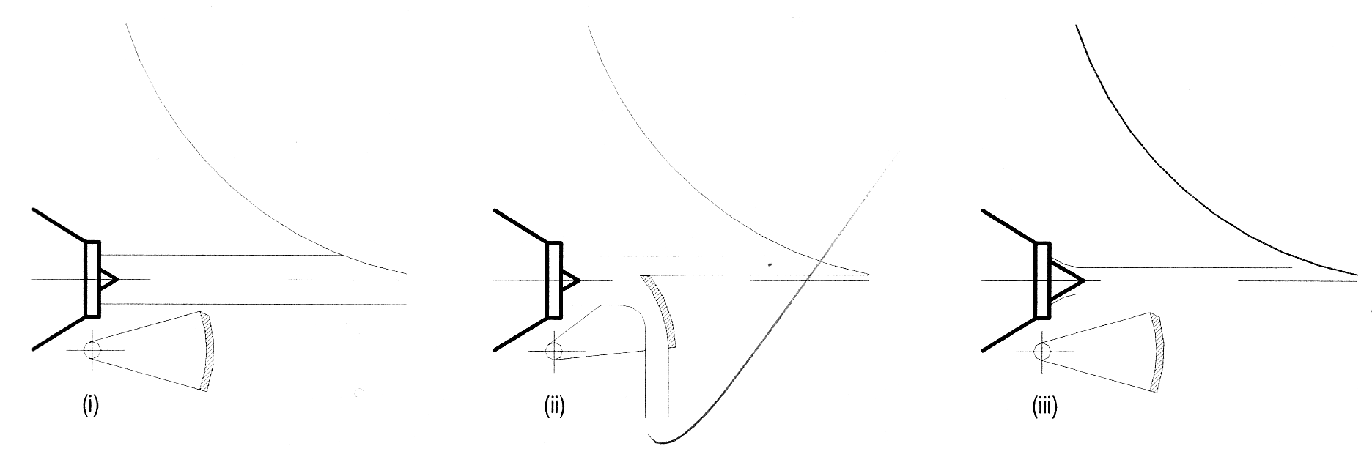
Combine spear and deflector operation to control turbine:

Slide 27
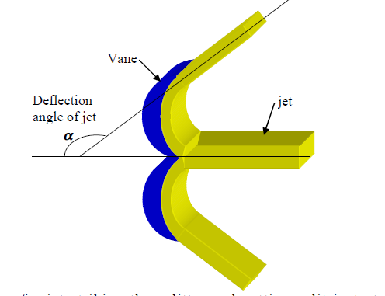

Slide 28
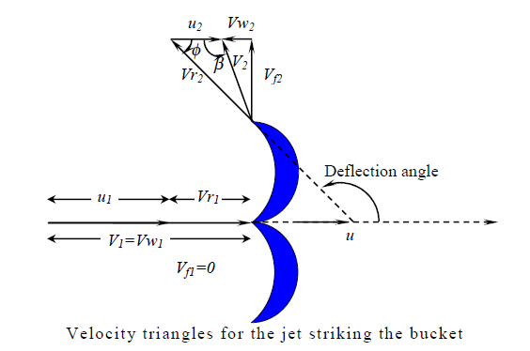

Slide 29
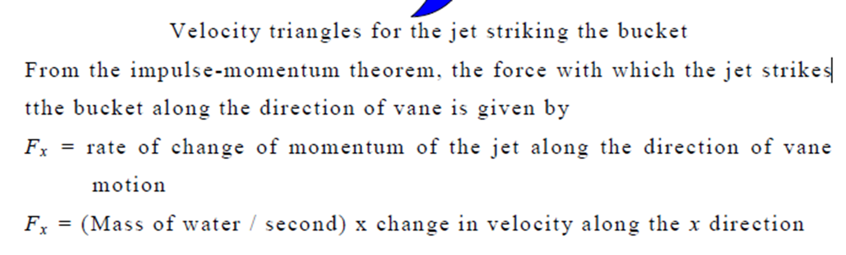
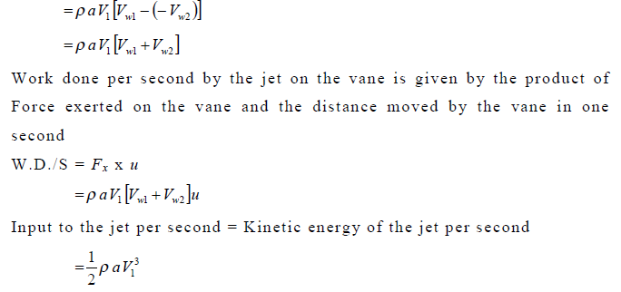

Slide 30
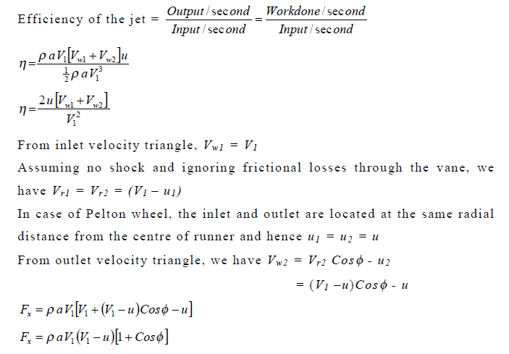

Slide 31
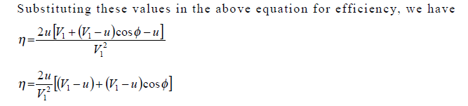
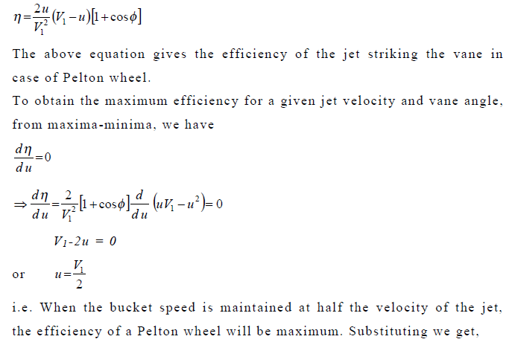

Slide 32
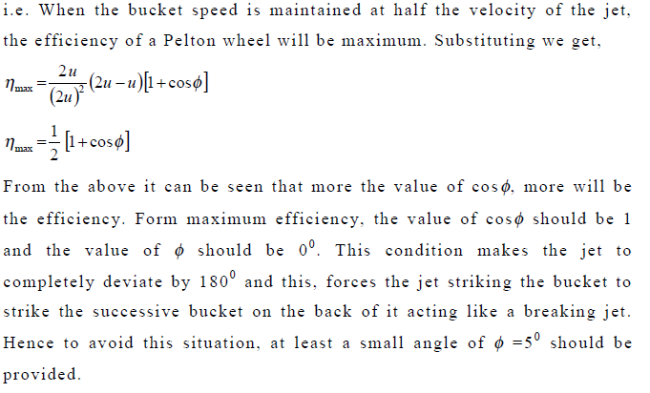

Slide 33
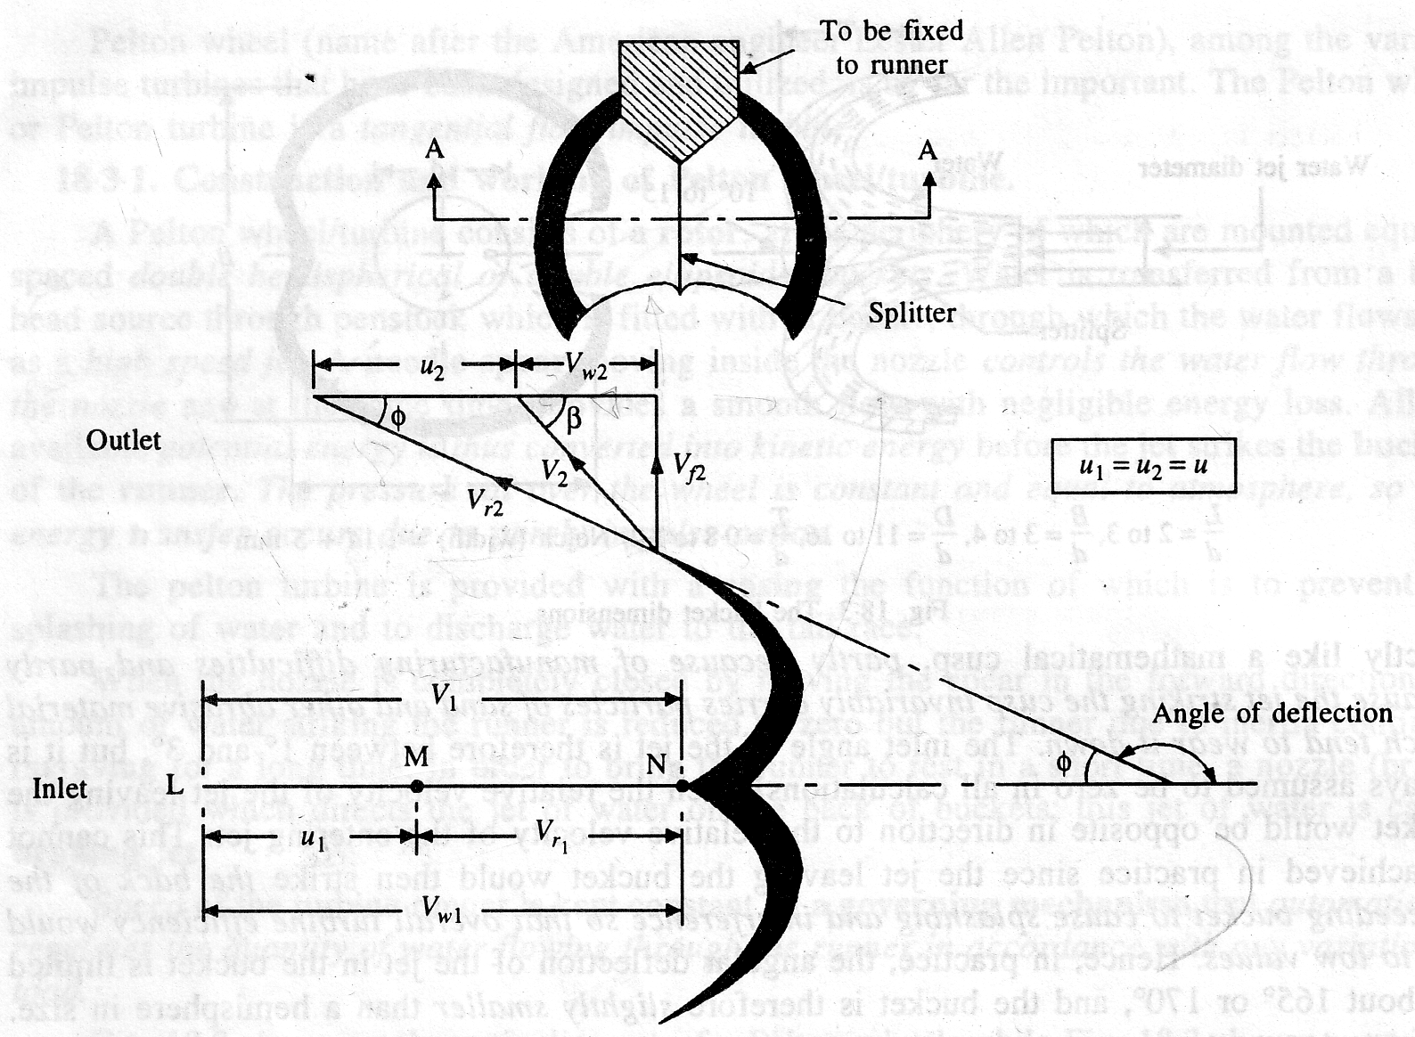
4.Calculations Velocity Δ-1:
N= speed of wheel in rpm
D= diameter of the wheel
d= diameter of jet
u= peripheral (circumferential) velocity of runner
= it will be same at inlet and out let of the runner at mean pitch. ( ie u=u₁=u₂)
= (πDN) / 60

Slide 34
Calculations Velocity :Work done SKIP
V_{l} = absolute velocity of water at inlet, V_{r1} =jet velocity relative to vane/bucket at inlet , α= angle between the direction of the jet and direction of motion of the vane bucket (also called guide angle), θ= angle make by the relative velocity (V_{r1} ) with the direction of motion at inlet (also called vane angle at inlet),

Slide 35
Calculations Velocity Δ:Work done SKIP
V_{wl} and V_{f1} =the components of the velocity of the jet V₁, in direction of motion and perpendicular to the direction of motion of the vane respectively, V_{w1} is also known as velocity of whirl at inlet, V_{f1} is also known as velocity of flow at inlet

Slide 36
Calculations Velocity Δ:Work done
V₁,V₁₂ , α=0, θ=0, V_{w1} ,V_{f1} are corresponding values at inlet. V₂,V_{r2} , φ, β, V_{w2} ,V_{f2} are corresponding values at outlet. Inlet. The velocity triangle at inlet will be a straight line where

Slide 37
Calculations Velocity Δ:Work done
Depending upon magnitude of the peripheral speed (u), the unit may have a slow, medium or fast runner and the angle R and Vwz will vary as follows: (i) Slow runner β< 90° (Vw2 is -ve) (ii) Medium runner β = 90° (Vw2 = 0) (iii) Fast runner β > 90° (Vw2 is +ve) The force exerted by the jet of water in the direction of motion is given as

Slide 38
Calculations Velocity :Work done
V_{r1} = V₁-u₁=V_{w1}-u₁ and V_{r2} cosφ = V_{w2}+u₂ V_{w2}= V_{r2} cosφ -u₂= V_{r1} cosφ -u₂=(V₁-u₁)cosφ -u₂ u1=u2=u Now work done by tie jet on runner per second = F × u = ρaV₁ (V_{r1} + V_{r2} cosφ ) ×u =ρaV₁ (V_{w1}-u₁ + V_{w2}+u₂ ) ×u =ρaV₁(V_{w1}+ V_{w2})×u=ρaV₁[V₁+(V₁-u₁)cosφ-u₂] ×u = ρaV₁(V₁-u₁)(1+cosφ)×u η_{H}= work done per sec / KE of jet per sec = ρaV₁(V₁-u₁)(1+cosφ)×u / 1/2×(ρaV₁) V₁² For η_{Hmax} d η_{Hmax} /du=0 then η_{Hmax} = (1+cos φ ) / 2

Slide 39
5.Design aspects of pelton wheel-1:
Velocity of jet: The velocity of jet at inlet is given by:
V₁ = C_{v}√(2g H)
C_{v} = co-efficient of velocity (= 0•98 or 0.99)
H = net head on turbine.

Slide 40
5.Design aspects of pelton wheel-2:
2. Velocity of wheel: The velocity of wheel (u) is given by:
u = K_{u}√2g H
K_{u} = speed ratio. It varies from 0.43 to 0.48

Slide 41
5.Design aspects of pelton wheel-3:
3. Angle of deflection of the jet: The angle of deflection of the jet through the buckets
is taken as 165° if no angle of deflection is given.

Slide 42
5.Design aspects of pelton wheel-4:
5. Mean diameter of the wheel (D): The mean diameter or the pitch diameter D of the Pelton wheel is given by
u= = (πDN) / 60
D= 60u / πN

Slide 43
5.Design aspects of pelton wheel-5:
5.Jet ratio (m): It is defined as the ratio of the pitch diameter (D) of the Pelton wheel to the diameter of the jet (d). It is denoted by `m' and is given as
m=D/d
m=lies between 1 1 and 16 for maximum hydraulic efficiency
Normally, the jet ratio is adopted as 12 in practice.

Slide 44
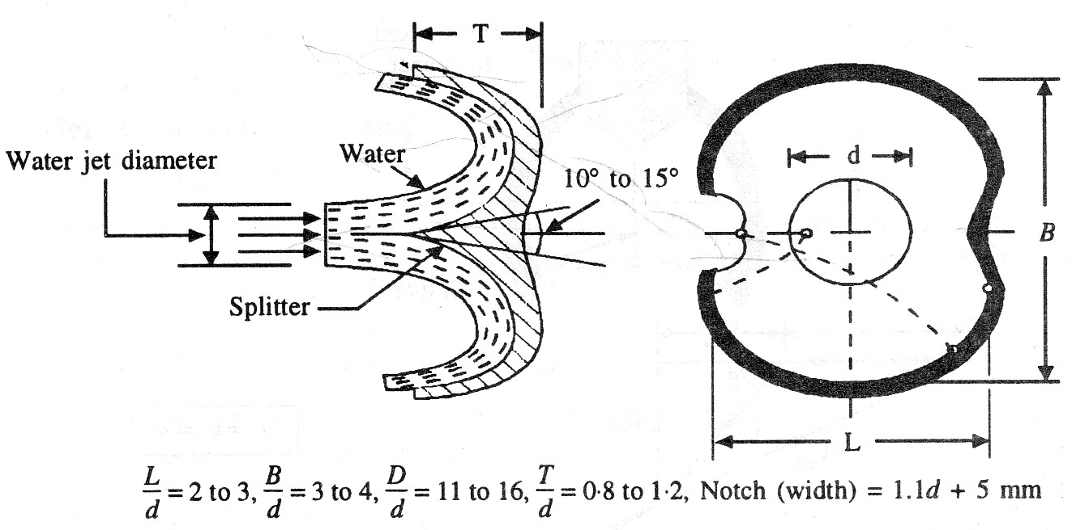
5.Design aspects of pelton wheel-6:
6.Bucket dimensions: Some of the main dimensions of the bucket of a Pelton wheel are as follows :
B= 3 to 4d; L=2 to 3d; T=0-8 to 1•2d ;
T
B
L

Slide 45
5.Design aspects of pelton wheel-7: Bucket dimensions:

Slide 46
5.Design aspects of pelton wheel-8 No. of nozzles:
Normally 1 nozzle or jet.
To produce more power with same wheel = no. of nozzles.
Max nozzles = 6
Normally not more than 2 nozzles for per vertical runner.
Normally not more than 4 nozzles for horizontal runner.
No. of nozzle = total Q through T/ Q through one nozzle

Slide 47
5.Design aspects of pelton wheel-8: No. of buckets (Z):
It should be such that the jet is always completely intercepted by the buckets so that η_{vol} is very close to 1.
Z = 15 +D/2d

Slide 48
6. η_{Hydraulic} 1
η_{H}= power developed by the runner / power supplied at the inlet of T
₌ [ρaV₁ (V_{w1} + V_{w2}) ×u] / ρgHQ_{a}
= 90~95

Slide 49
6. η_{Mechanical} 2
η_{M}= power available at T shaft / power developed by the T runner
= shaft power / bucket power (power develop by runner)
₌ P / [ρaV₁ (V_{w1} + V_{w2}) ×u]
= 97~99
It is due to bearing friction etc.

Slide 50
6. η_{Volumetric} 3
η_{V}= [vol. of water actually striking the runner] / [total water supplied by the jet to the turbine]
= Q_{a} /Q
= 97~99

Slide 51
6. η_{Over all} 4
η_{O}= [power available at the turbine shaft] / [power available from the water jet]
₌ shaft power / water power
= P / ρgHQ
= 85~90
η_{O}= η_{H} ×η_{M} ×η_{V}

Slide 52
6. η_{generator}( η_{G} ) 5:
6.Hydraulic electric plant efficiency-6:
η_{HE} = η_{G}× η_{O}
η_{HE =} P_{out of HE /} ρgHQ
_{END OF PELTON TURBINE}

Slide 53
7.Pelton turbine in Nepal
The major power plant having pelton turbine are
Kulekhani first (30x2)MW
Puwa khola (3x2) MW
Sundarijal (300x2)KW
Pharping (250x2)KW
Khimti (12x5)MW
Chilime (11X2)MW
Adhikhola (1.7x3)MW
Piluwa-turgo (1.5x2)MW

